Slide 1
NODE.JS
(The Backend Of MERN Stack)
Lecture 2

Slide 2
Today’s Agenda
Installing Node.Js
Two Ways To Use Node.Js
What Is REPL ?
Developing First Node.JS Code

Slide 3
Installing node js
To install Node.js we must visit Node.js official web site https://nodejs.org/en/download
It will automatically detect OS and display download link as per your Operating System.

Slide 4
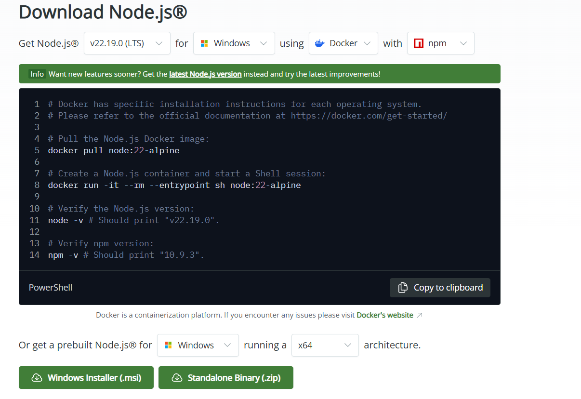
Installing node js
For example, it will display following download link for 64 bit Windows OS.
Click on the Wimdows Installer to download the setup file

Slide 5
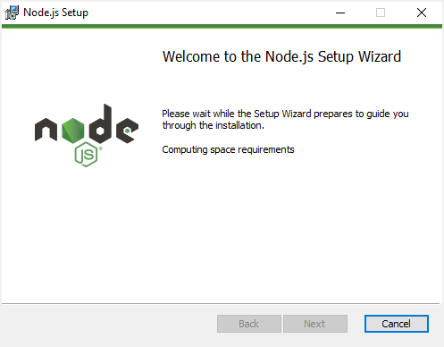
Installing node js
Now double-click the installer file that you have downloaded to launch the setup wizard.
First, the setup wizard will compute space requirements:

Slide 6
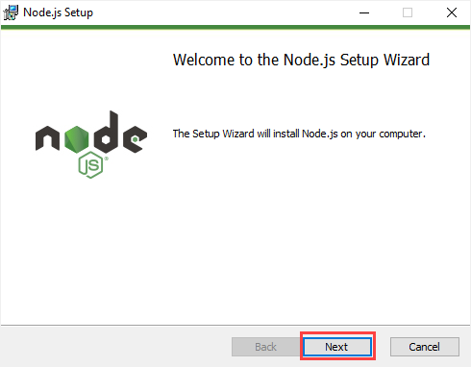
Installing node js
Once completed, click the Next button to go to the next step:

Slide 7
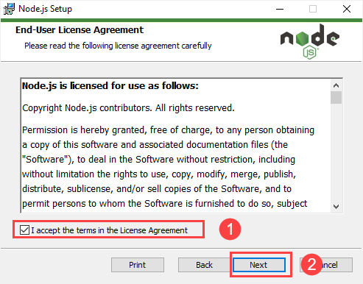
Installing node js
Second, you need to accept the end-user license agreement and click the Next button.

Slide 8
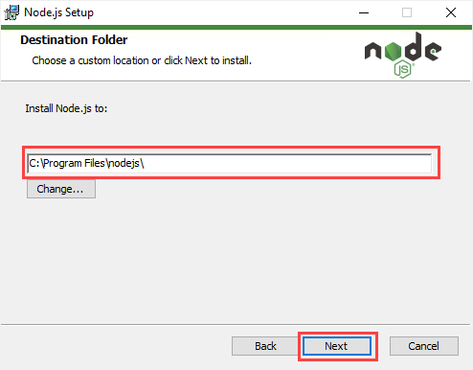
Installing node js
Third, you can select a folder to install Node.js and click the Next button.
It defaults to C:\Program Files\nodejs\.

Slide 9
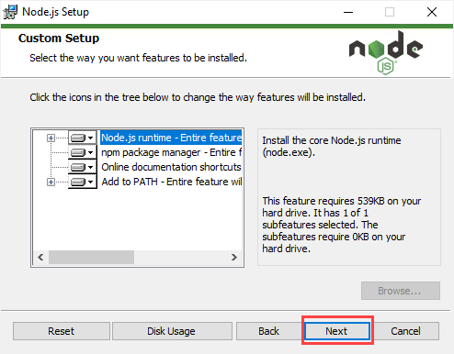
Installing node js
Fourth, leave the default options, the setup wizard will install Node.js runtime, npm package manager, and online documentation shortcuts.

Slide 10
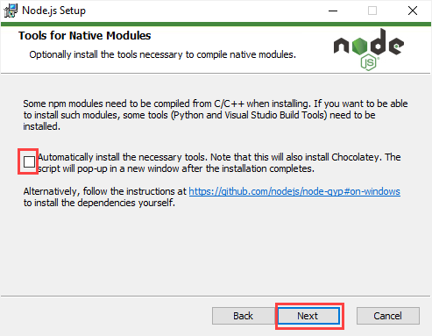
Installing node js
Fifth, select the checkbox to install the necessary tools, including Chocolatey and click the Next button.

Slide 11
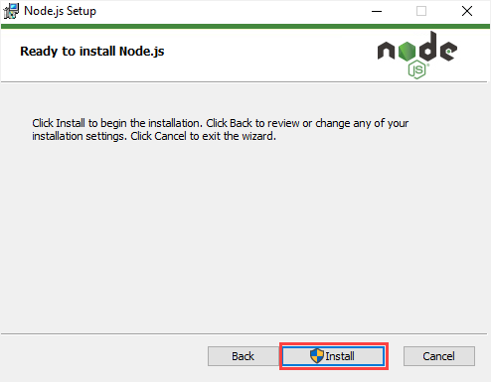
Installing node js
Sixth, click the Install button to begin the installation.

Slide 12
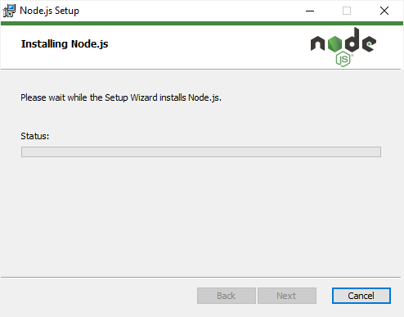
Installing node js
Seventh, you need to wait while the setup wizard installs Node.js

Slide 13
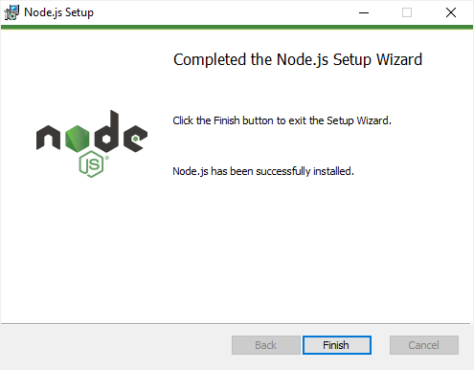
Installing node js
Eight, click the Finish button to exit the setup wizard.

Slide 14
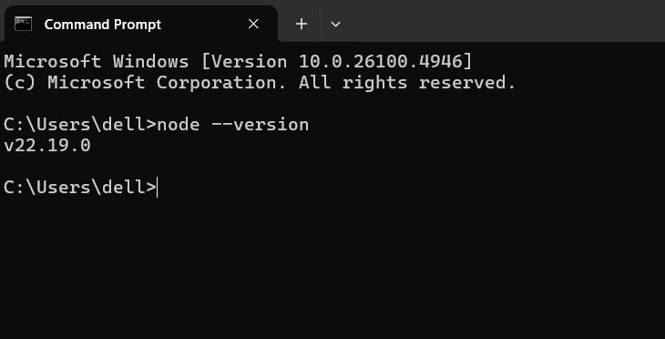
Verifying the installation
To confirm the installation, you can open Command Prompt and type the following command:

Slide 15
Two ways to use node.js
Once we have installed Node.js , we can interact with it in 2 ways:
1. Using Node Shell
2. Using Node Scripts

Slide 16
Using node shell
Node.js comes with virtual environment called Node Shell , also known as REPL which stands for Read-Eval-Print-Loop.
It is a quick and easy way to test simple Node.js/JavaScript code.

Slide 17
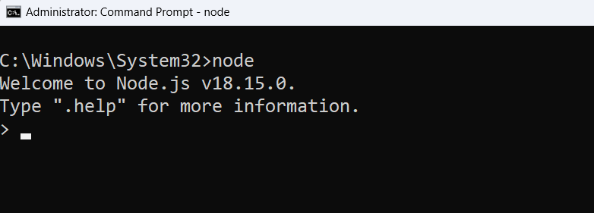
Using node shell
To launch the REPL , open command prompt and type node as shown below.
It will change the prompt to >

Slide 18
Using node shell
You can now test any Node.js/JavaScript expression in REPL.
10 + 20 will display 30 immediately in new line.
“Hello” + “User” will display ‘HelloUser’

Slide 19
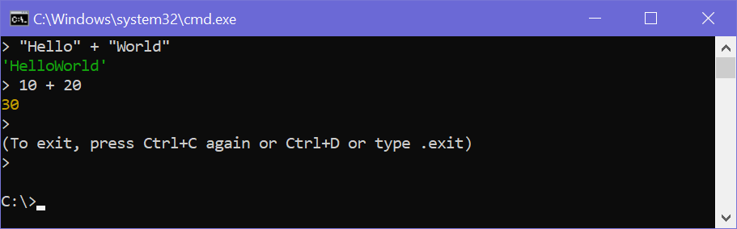
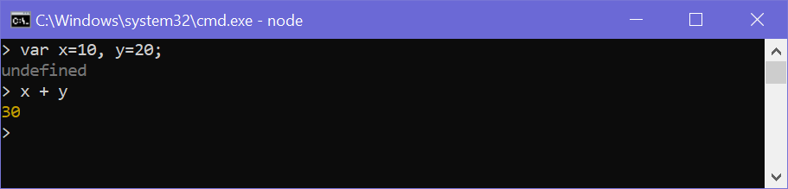
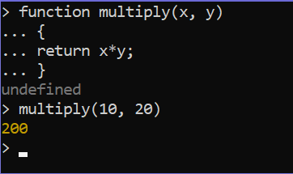
Using node shell

Slide 20
Using node scripts
Using the Node REPL can be useful, but it is definitely not the way we'll be writing and executing code, just like we don't use the chrome console to type applications and to write long scripts.
What we do instead is write our code in a JavaScript file.
So let's do that here.

Slide 21
Using node scripts
Follow the below mentioned steps to use Node in script mode:
1. Create a folder to be used as your workspace.
2. Open this folder in VS Code.
3. Create a new JS file in VS Code in your workspace folder.
4. Let’s call the file app.js
5. The entire environment will look as shown in the next slide

Slide 22
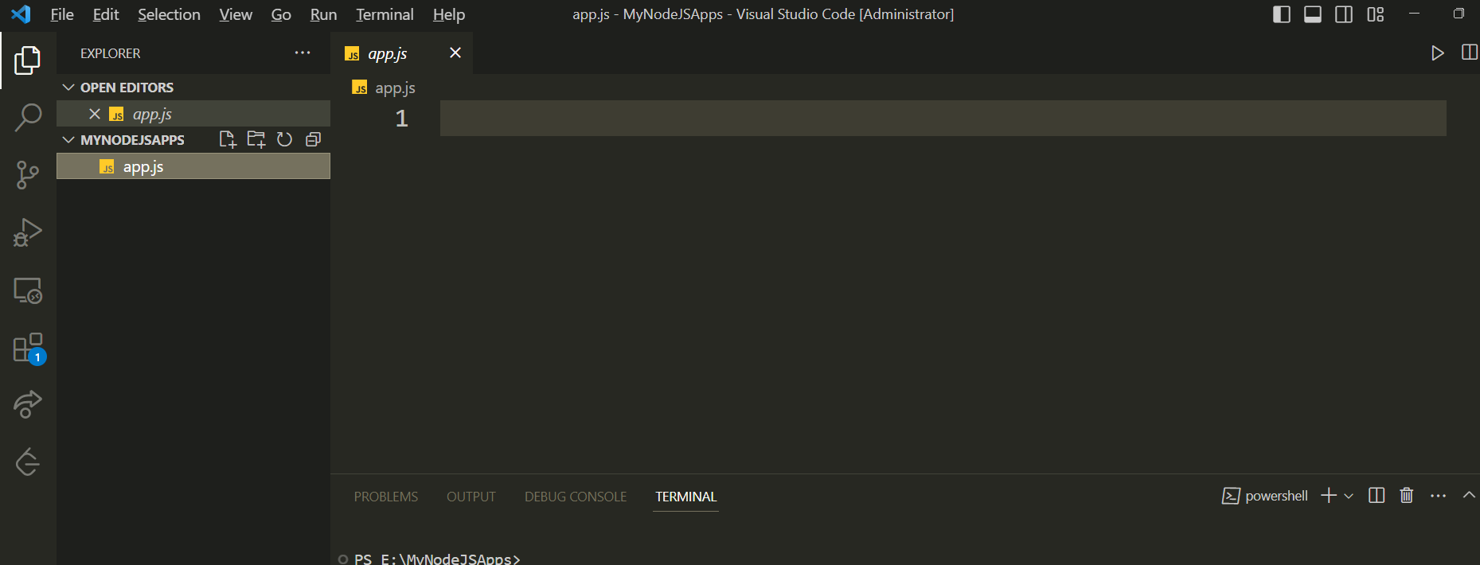
Using node scripts

Slide 23
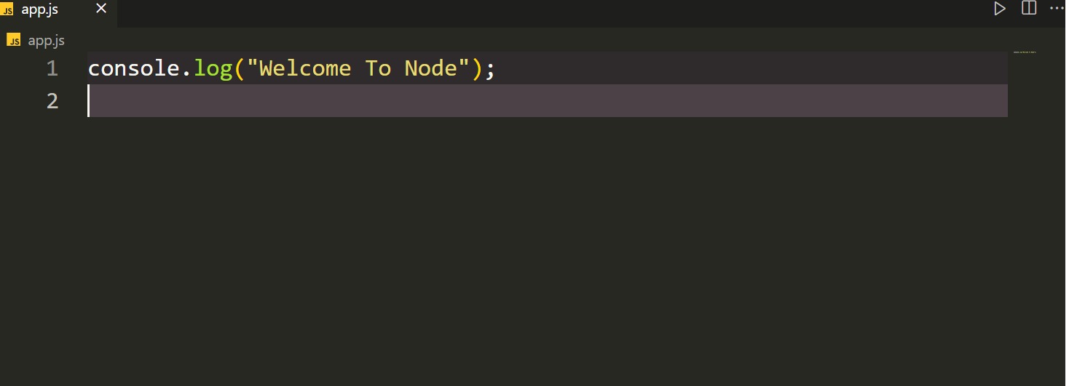
Using node scripts
Now type the following code in app.js

Slide 24
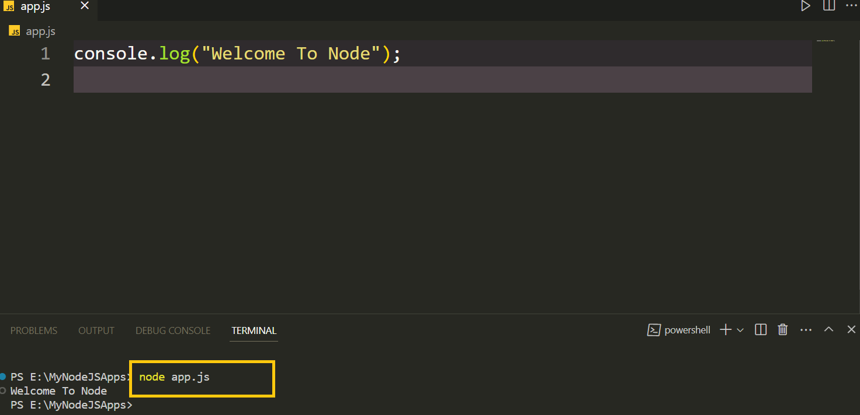
Using node scripts
Finally open the terminal in VS Code and run the file by typing the following command=> node app.js

